Slide 1



iFBalance Robot
STEAM AI Education Platform
Shantanu Sen Gupta
Manager, Research Institute
www.koreaits.com
(주)인디프로그

Slide 2
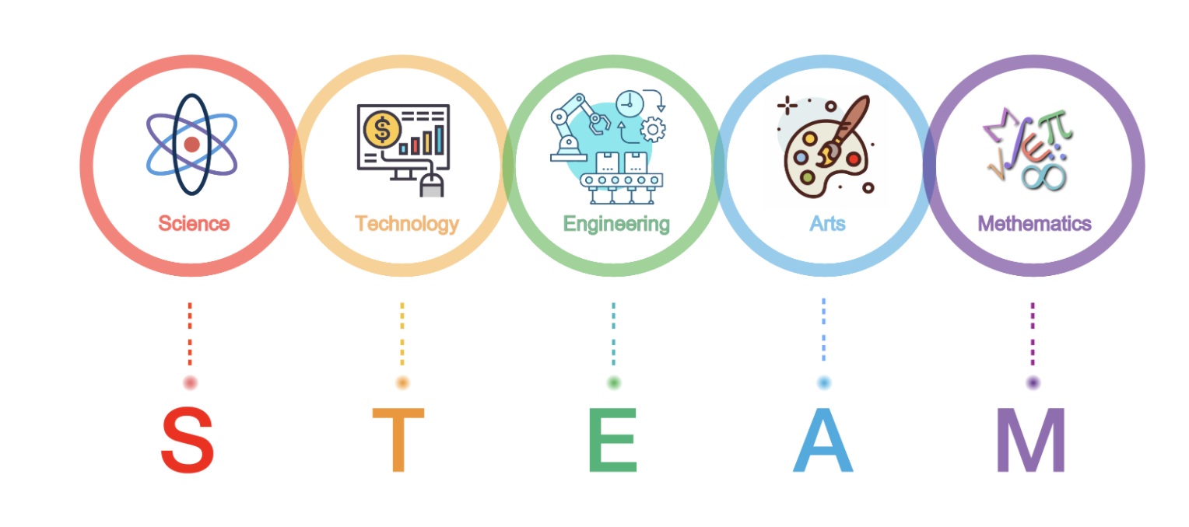
iFBalance
+
AI
Notes:
delete

Slide 3
iFBalance
Day1
Day 3
Day 4
Day 2
Notes:
delete

Slide 4
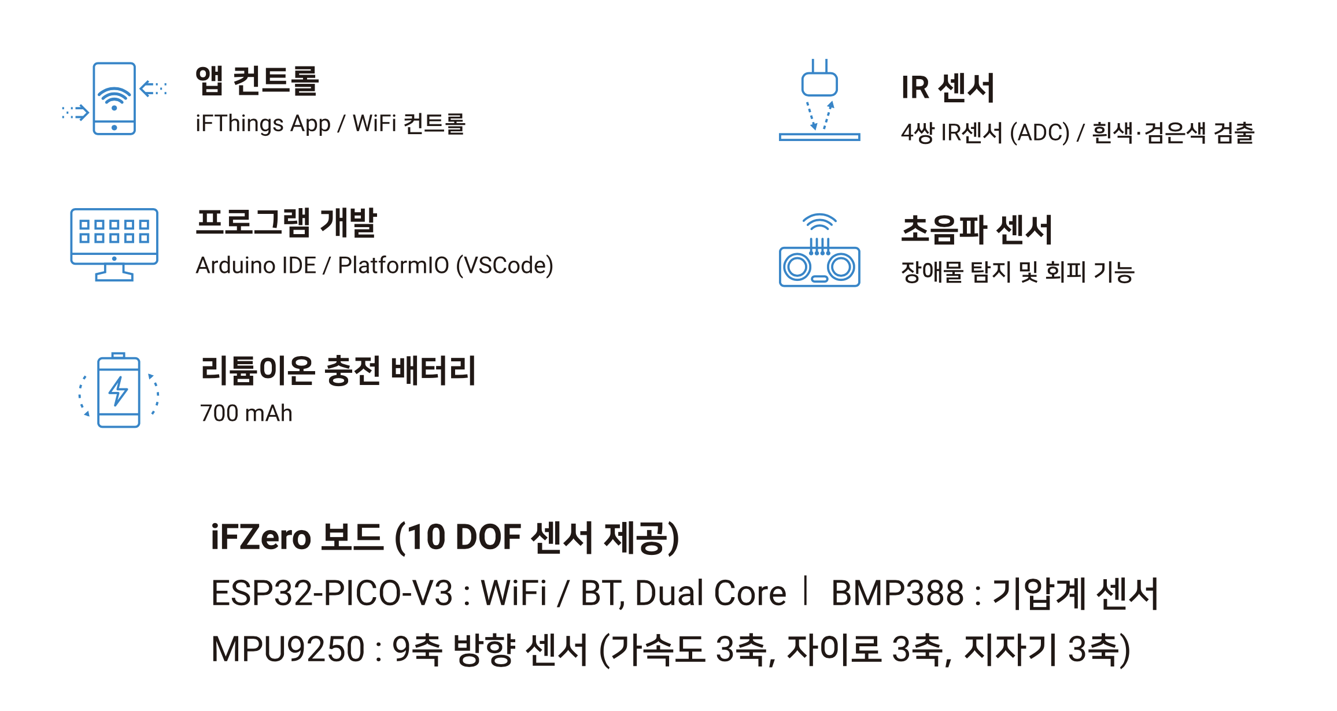
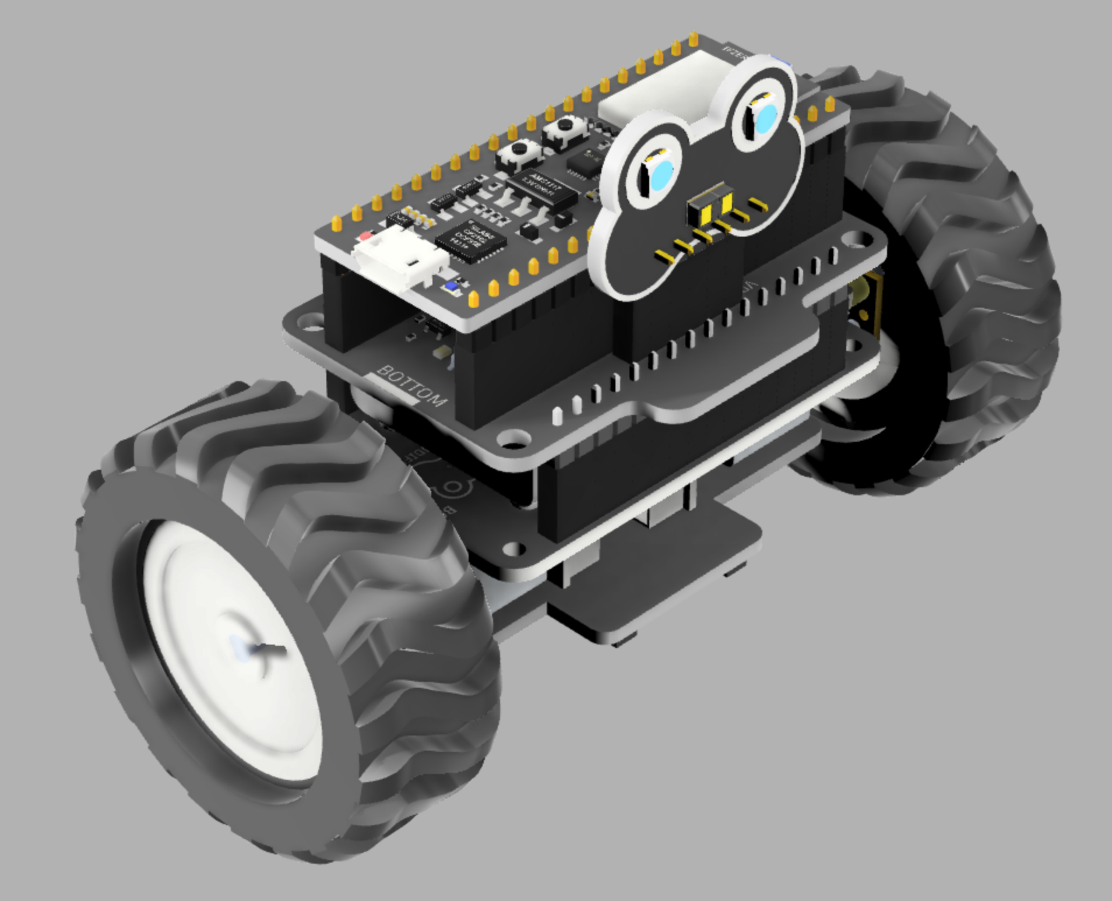


iFBalance
Features

Slide 5
iFBalance

Slide 6
iFBalance
iFZero Module
Notes:
delete

Slide 7
iFBalance
iFThings App
https://play.google.com/store/apps/details?id=com.indifrog.ifthings
https://apps.apple.com/kr/app/ifthings/id1552208956

Slide 8

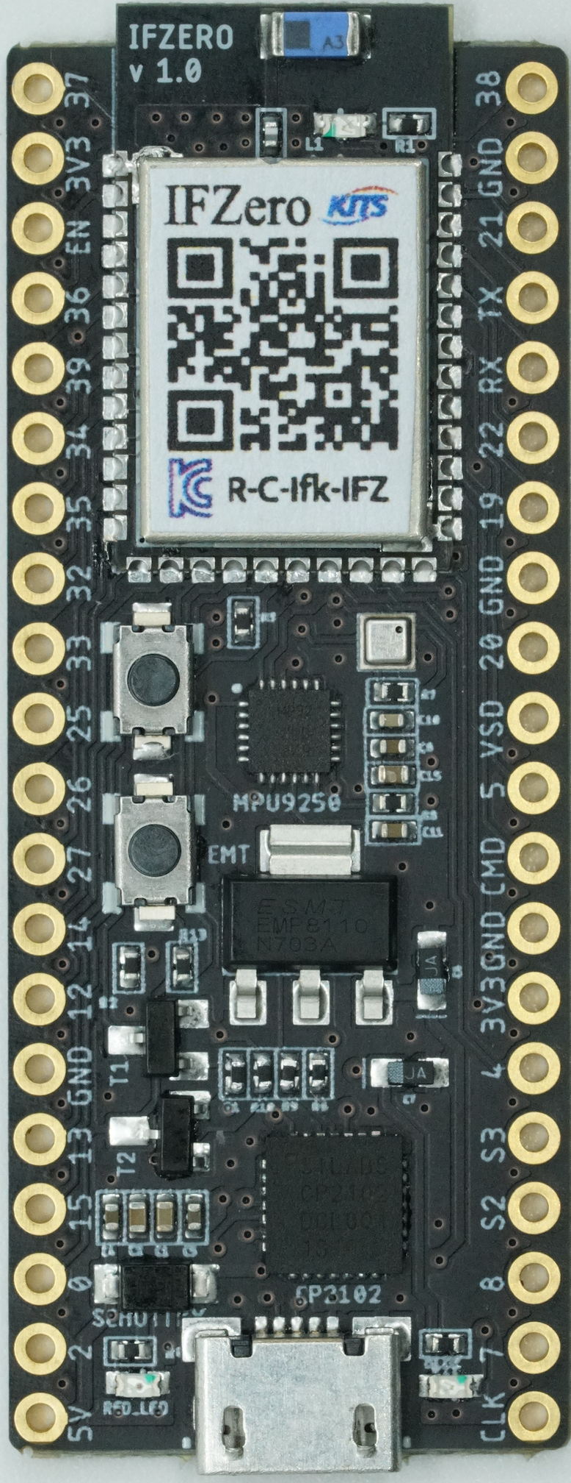
iFBalance
iFZero Board
Development Tools
Arduino
PlatformIO
Native
ESP32 PICO V3
Xtensa® Dual Core 32-bit CPU
WiFi 2.4 GHz
Bluetooth
4 MB Flash Memory
34 programmable GPIOs
12 bit SAR ADC x 18
RTC
BMP388
Pressure Sensor
200 ~ 1250 hPa
30cm Error
I2C
200Hz Sampling
RESET Button
MPU9250
Triple Axis MEMS
Accelerometer 3 Axis
Gyroscope 3 Axis
Magnetometer 3 Axis
400KHz Fast Mode I2C
Digital Motion Processing
GPIO 0 Button
CP2102
USB2Serial
300 ~ 921600 bps

Slide 9
iFBalance
Environment Setup

Slide 10

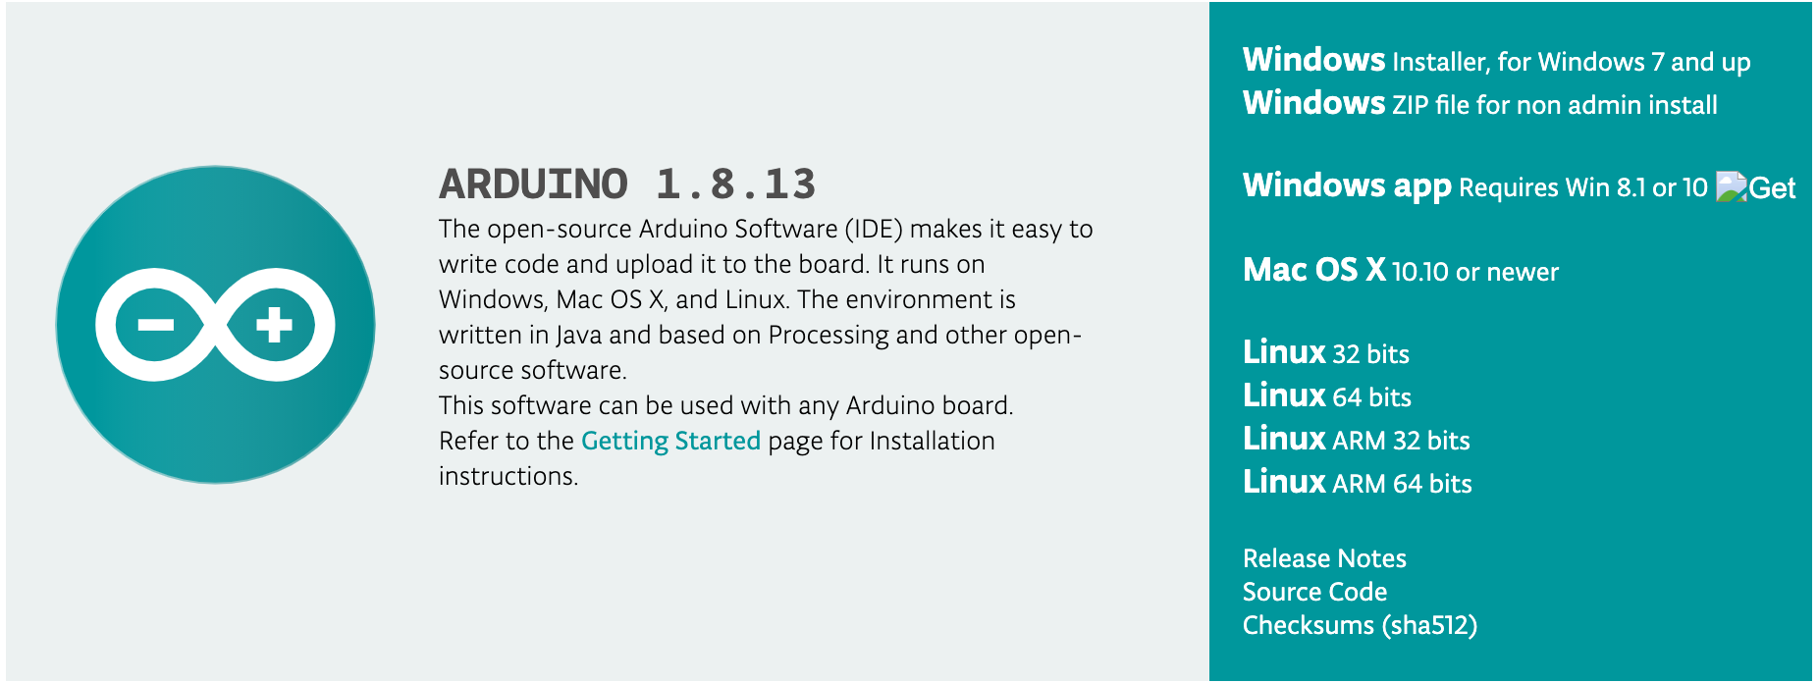
iFBalance
Code it!!
1. Arduino
2. Visual Studio Code
https://www.arduino.cc/en/Main/Software
https://code.visualstudio.com/

Slide 11
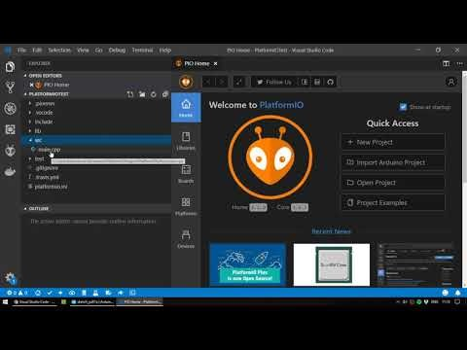
iFBalance
Install Visual Studio Code
&
PlatformIO

Slide 12
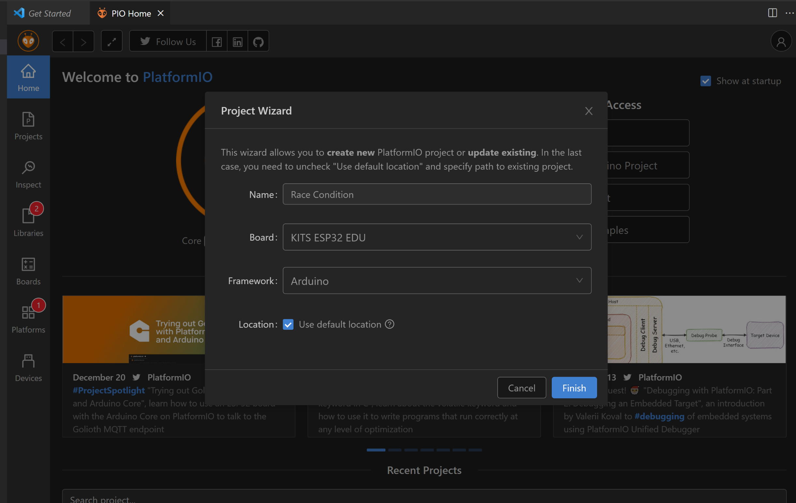
iFBalance
Code in Visual Studio Code
&
PlatformIO

Slide 13
iFBalance
Code in Visual Studio Code
&
PlatformIO

Slide 14
iFBalance
Add a Library
in
PlatformIO

Slide 15
iFBalance
Configure PlatformIO.ini
[env:pico32]
platform = espressif32
board = pico32
framework = arduino
; ///// 추가함 ////// by serimo 2020.07.25
upload_speed = 921600
monitor_speed = 115200
monitor_port = COM9 ; Windows
; monitor_port = /dev/cu.SLAB_USBtoUART. ; Mac
lib_deps =
# RECOMMENDED
# Accept new functionality in a backwards compatible manner and patches
makuna/NeoPixelBus @ ^2.6.0
# Accept only backwards compatible bug fixes
# (any version with the same major and minor versions, and an equal or greater patch version)
makuna/NeoPixelBus @ ~2.6.0
# The exact version
makuna/NeoPixelBus @ 2.6.0
Automatic

Slide 16
iFBalance
Upload a Program
in
PlatformIO
Serial
Monitor
Upload
Compile

Slide 17

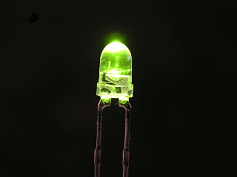
iFBalance
1st Program
Blink LED
https://github.com/ShantanuSen/KookminSeminar/tree/main/LED%20Blinking

Slide 18
iFBalance
iFZero Board GPIO Connection
IR_LEFT_L
I37
I38
IR_RIGHT_R
3V3
GND
EN
IO21
I2C SDA
IR_CENTER_LB
I36
TX
Battery
I39
RX
IR_CENTER_LF
I34
IO22
I2C SCL
IR_CENTER_RF
I35
IO19
IR_CENTER_C
IO32
GND
IR_LEFT_L IR_CENTER_C IR_RIGHT_R
IR_CENTER_RB
IO33
IO20
IR_TR_1
E_LEFT_A
IO25
VSD
M_RIGHT_B
IO26
IO5
IR_TR_2
IR_CENTER_LB IR_CENTER_RF
M_RIGHT_F
IO27
CMD
E_LEFT_B
IO14
GND
IO12
3V3
GND
IO4
IR_TR_3
IR_CENTER_LF IR_CENTER_RB
E_RIGHT_A
IO13
S3
E_RIGHT_B
IO15
S2
TOF_INT
Button
IO0
IO8
M_LEFT_B
COLOR_LED
IO2
IO7
M_LEFT_F
5V
CLK
IO4 ( BLUE LED )

Slide 19
iFBalance
RGB LED

Slide 20
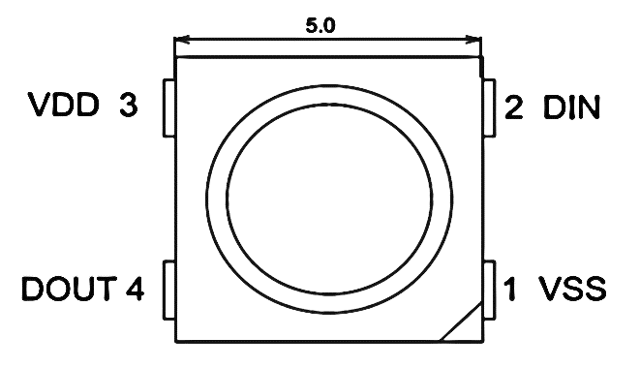
iFBalance
Color LED (SK6812)
GPIO_2

Slide 21
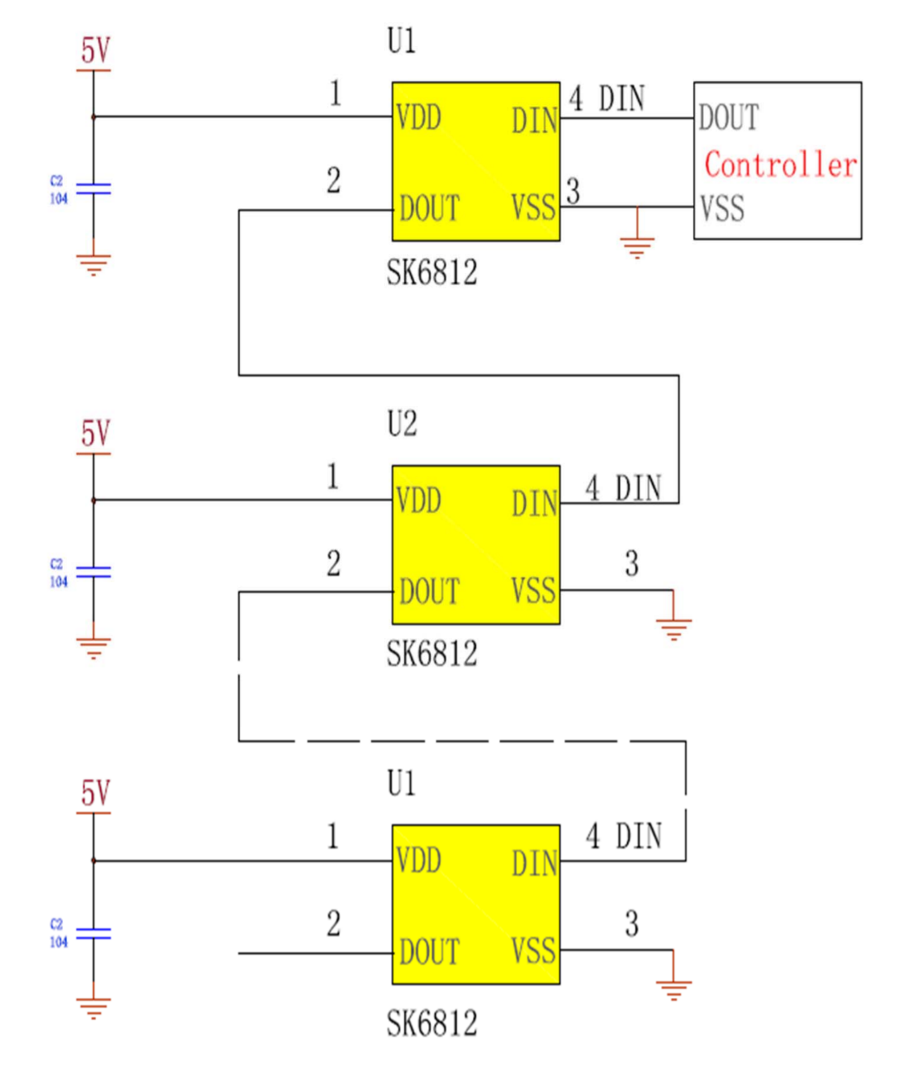
iFBalance
Color LED (SK6812)
In iFBalance
4 RGB LED

Slide 22
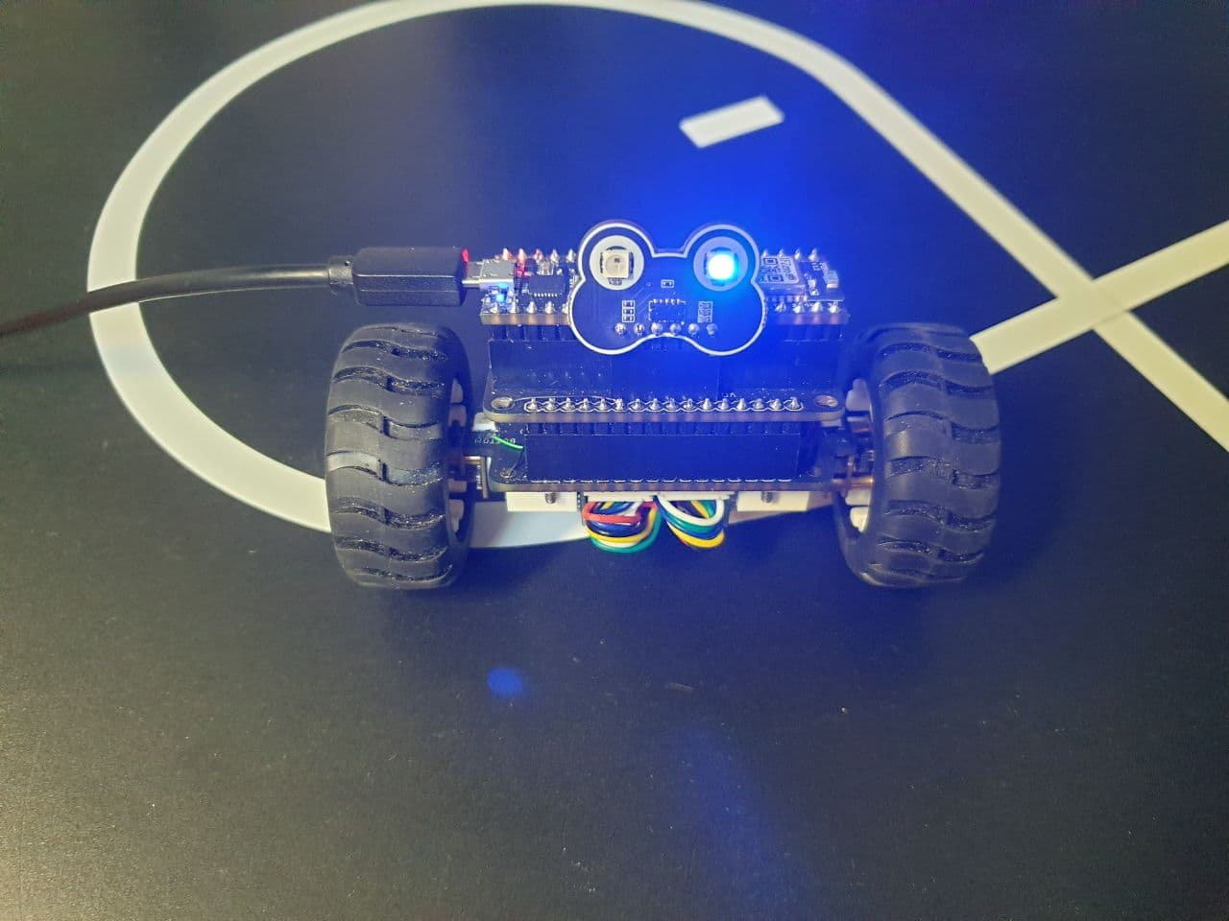
iFBalance
Color LED (SK6812)
LED 3
LED 4
LED 1
LED 2

Slide 23
iFBalance
Control SK6812 (NeoPixelBus)
RgbColor red(colorSaturation, 0, 0);
RgbColor green(0, colorSaturation, 0);
RgbColor blue(0, 0, colorSaturation);
RgbColor white(colorSaturation);
RgbColor black(0);
Define Color Brightness
int c = ++nPixel % 4;
strip.SetPixelColor(0, c==0? blue : black);
strip.SetPixelColor(1, c==1? green : black);
strip.SetPixelColor(2, c==2? red : black);
strip.SetPixelColor(3, c==3? blue : black);
strip.Show(); // Send the updated pixel colors to the hardware.
Set color to each LED

Slide 24
iFBalance
2nd Program
Control RGB LED
https://github.com/ShantanuSen/KookminSeminar/tree/main/Color%20LED_Part%201%20(Basic)

Slide 25
iFBalance
Real Time Operating System (RTOS)

Slide 26
iFBalance
Free RTOS
Several things concurrently

Slide 27
iFBalance
Free RTOS
Task: set of program instructions loaded in memory
Thread: unit of CPU utilization with its own program counter and stack
Process: instance of a computer program
FreeRTOS: Task = Thread

Slide 28
iFBalance
Super Loop
Entry Point (main())
Setup
Task 1
Task 2
Task 3
Loop

Slide 29
iFBalance
Interrupt
Entry Point (main())
Setup
Task 1
Task 2
Task 3
Interrupt Service Routine
(ISR)
Loop

Slide 30
iFBalance
RTOS
Entry Point (main())
Setup
Task A
Task B
Task C

Slide 31
Free RTOS
Asymmetric multiprocessing (AMP)
Symmetric multiprocessing (SMP)
Primary
Core
(Run OS )
Secondary Core
Primary
Core
(Run OS )
Primary
Core
(Run OS )
Secondary Core
Secondary Core
Primary
Core
(Run OS )
Primary
Core
(Run OS )

Slide 32
AMP vs SMP
AMP
One core is primary core
Others are secondary
Primary core runs operating system (OS)
Cores may not be same architecture
SMP
Every core is primary core
Every core runs operating system (OS)
Cores are same architecture

Slide 33
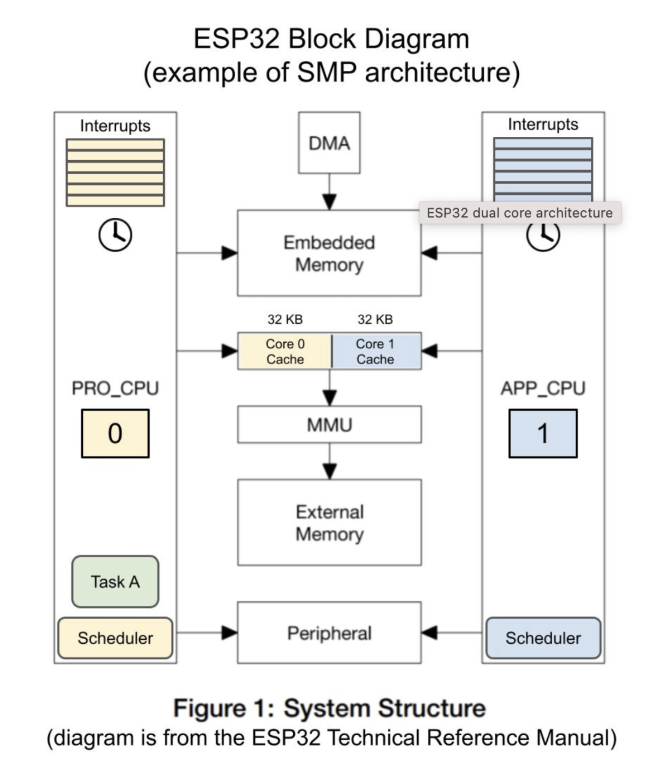
Interrupts
DMA
Interrupts
Embedded
Memory
32KB
32KB
PRO CPU
Core 0
Cache
Core 1
Cache
APP CPU
0
1
MMU
External
Memory
Task A
Scheduler
Peripheral
Scheduler

Slide 34
iFBalance
Free RTOS
Create a Task
void taskToggleBlueLED(void *pvParameter) {
portTickType delay = *(portTickType*)pvParameter;
digitalWrite(pinBlueLED, LOW);
vTaskDelay(delay/portTICK_PERIOD_MS);
}
non-blocking
1 ms

Slide 35
iFBalance
Free RTOS
Assign a Task
xTaskCreatePinnedToCore (taskToggleBlueLED, // function to be called
"Toggle Blue LED",, // name of task
1024, // stack size(in bytes)
(void*)&timeDelay, // param. To pass to function
uxTaskPriorityGet(NULL), //task priority
&TaskHandle, //task handle
0); // core number

Slide 36
iFBalance
Free RTOS
Task Scheduling
“Preemptive Scheduling”
ISR
(H/W)
Priority
(S/W)
1
Task B
Task C
Task C
0
Task A
Task A
Task A
Task A
OS
Idle
time

Slide 37
iFBalance
Free RTOS
Task States
Suspended
vTaskSuspend()
vTaskSuspend()
vTaskResume()
Task
Creation
Ready
Running
Event
Blocking API
Function called
vTaskSuspend()
Blocked

Slide 38
iFBalance
Free RTOS
Race Condition
void incTask(void *parameters) {
int local_var;
while(1) {
local_var = shared_var;
local_var ++;
vTaskDelay(500 / portTICK_PERIOD_MS);
shared_var = local_var;
Serial.println(shard_var);
}
}
Global variable
critical
section

Slide 39
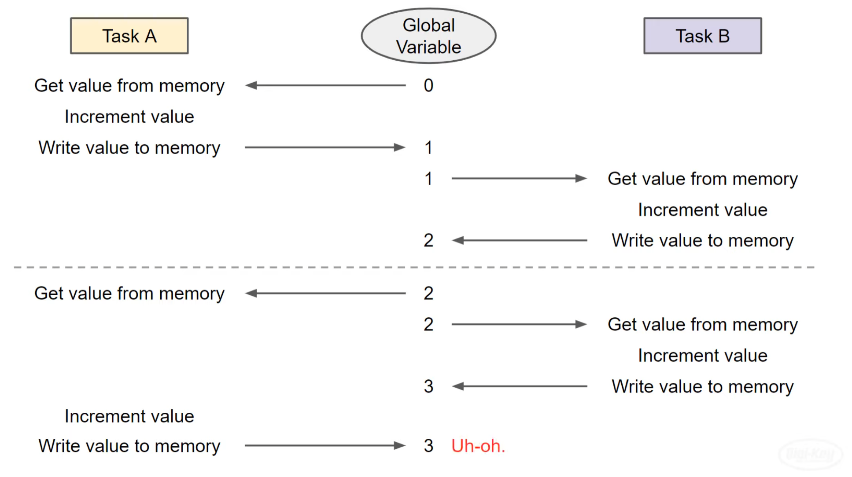
iFBalance
Free RTOS
Before Mutex

Slide 40
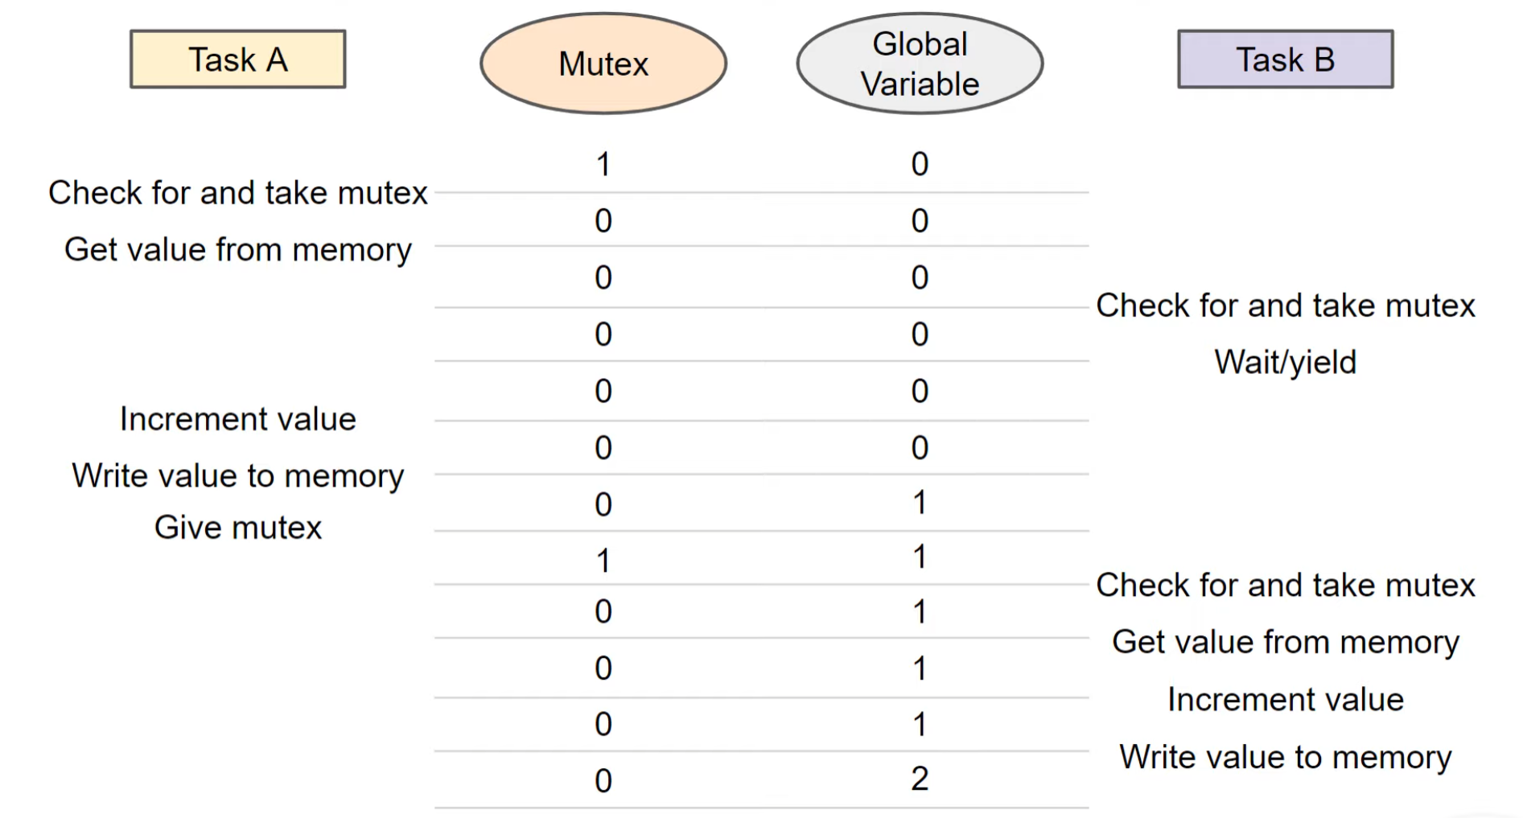
iFBalance
Free RTOS
After Mutex

Slide 41
iFBalance
Free RTOS
Mutual Exclusion (MUTEX)
void incTask(void *parameters) {
int local_var;
while(1) {
// take mutex prior to critical section
if (xSemaphoreTake (mutex, 0) == pdTRUE) {
local_var = shared_var;
local_var ++;
vTaskDelay(500 / portTICK_PERIOD_MS);
shared_var = local_var;
// give mutex prior to critical section
xSemaphoreGive (mutex);
Serial.println(shared_var);
}
}
static SemaphoreHandle_t mutex;

Slide 42
iFBalance
3rd Program
Play with onboard Blue LED using FreeRTOS
https://github.com/ShantanuSen/KookminSeminar/tree/main/Free%20RTOS%20Basic%20(LED%20Blink)

Slide 43
iFBalance
Free RTOS
Blink LED from Protocol CPU
xTaskCreatePinnedToCore( // Use xTaskCreate() in vanilla FreeRTOS
taskToggleBlueLED, // Function to be called
"Toggle BLUE LED", // Name of task
1024, // Stack size (bytes in ESP32, words in FreeRTOS)
(void*)&timeDelay, // Parameter to pass to function
uxTaskPriorityGet(NULL), // Task priority (0 to configMAX_PRIORITIES - 1)
&taskHandle, // Task handle
PRO_CPU); // core No.

Slide 44
iFBalance
Free RTOS
Blink LED from Protocol & Application CPU
xTaskCreatePinnedToCore( // Use xTaskCreate() in vanilla FreeRTOS
taskToggleBlueLED, // Function to be called
"Toggle BLUE LED", // Name of task
1024, // Stack size (bytes in ESP32, words in FreeRTOS)
(void*)&timeDelay, // Parameter to pass to function
uxTaskPriorityGet(NULL), // Task priority (0 to configMAX_PRIORITIES - 1)
&taskHandle, // Task handle
PRO_CPU); // core No.
xTaskCreatePinnedToCore(taskToggleBlueLED2,
"Toggle Blue LED2",
1024,
(void*)&timeDelay2,
uxTaskPriorityGet(NULL),
&taskHandle,
APP_CPU); // change to PRO_CPU. What will happen?

Slide 45
iFBalance
4th Program
Create LED Class
&
Use with FreeRTOS
https://github.com/ShantanuSen/KookminSeminar/tree/main/Free%20RTOS%20Basic%20(LED%20Class)

Slide 46
iFBalance
5th Program
LED, Button, & FreeRTOS
https://github.com/ShantanuSen/KookminSeminar/tree/main/Free%20RTOS%20Basic%20(HW%20ISR)

Slide 47
iFBalance
6th Program
LED Flash witn Button, & FreeRTOS
https://github.com/ShantanuSen/KookminSeminar/tree/main/Free%20RTOS%20Basic%20(HW%20ISR)

Slide 48
iFBalance
7th Program
NeoPixel Class, & FreeRTOS
https://github.com/ShantanuSen/KookminSeminar/tree/main/Color%20LED_Part%202%20(FreeRTOS)

Slide 49
iFBalance
DC Motor Control

Slide 50
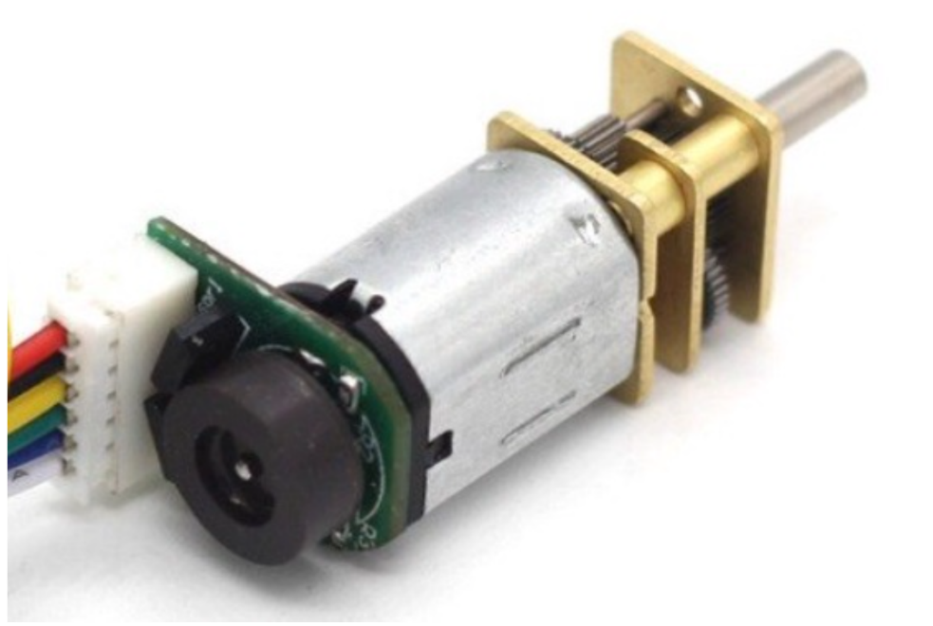
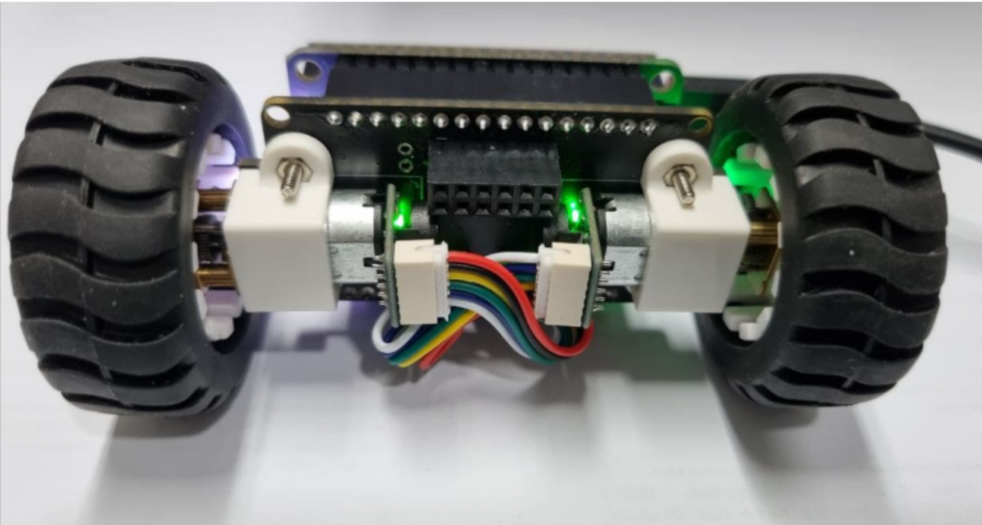
iFBalance
DC Motor
Right Motor
Left Motor

Slide 51
iFBalance
DC Motor
Motor Control GPIO
LEFT_WHEEL_FORWARD IO7
LEFT_WHEEL_BACKWARD IO8
RIGHT_WHEEL_FORWARD IO27
RIGHT_WHEEL_BACKWARD IO26

Slide 52
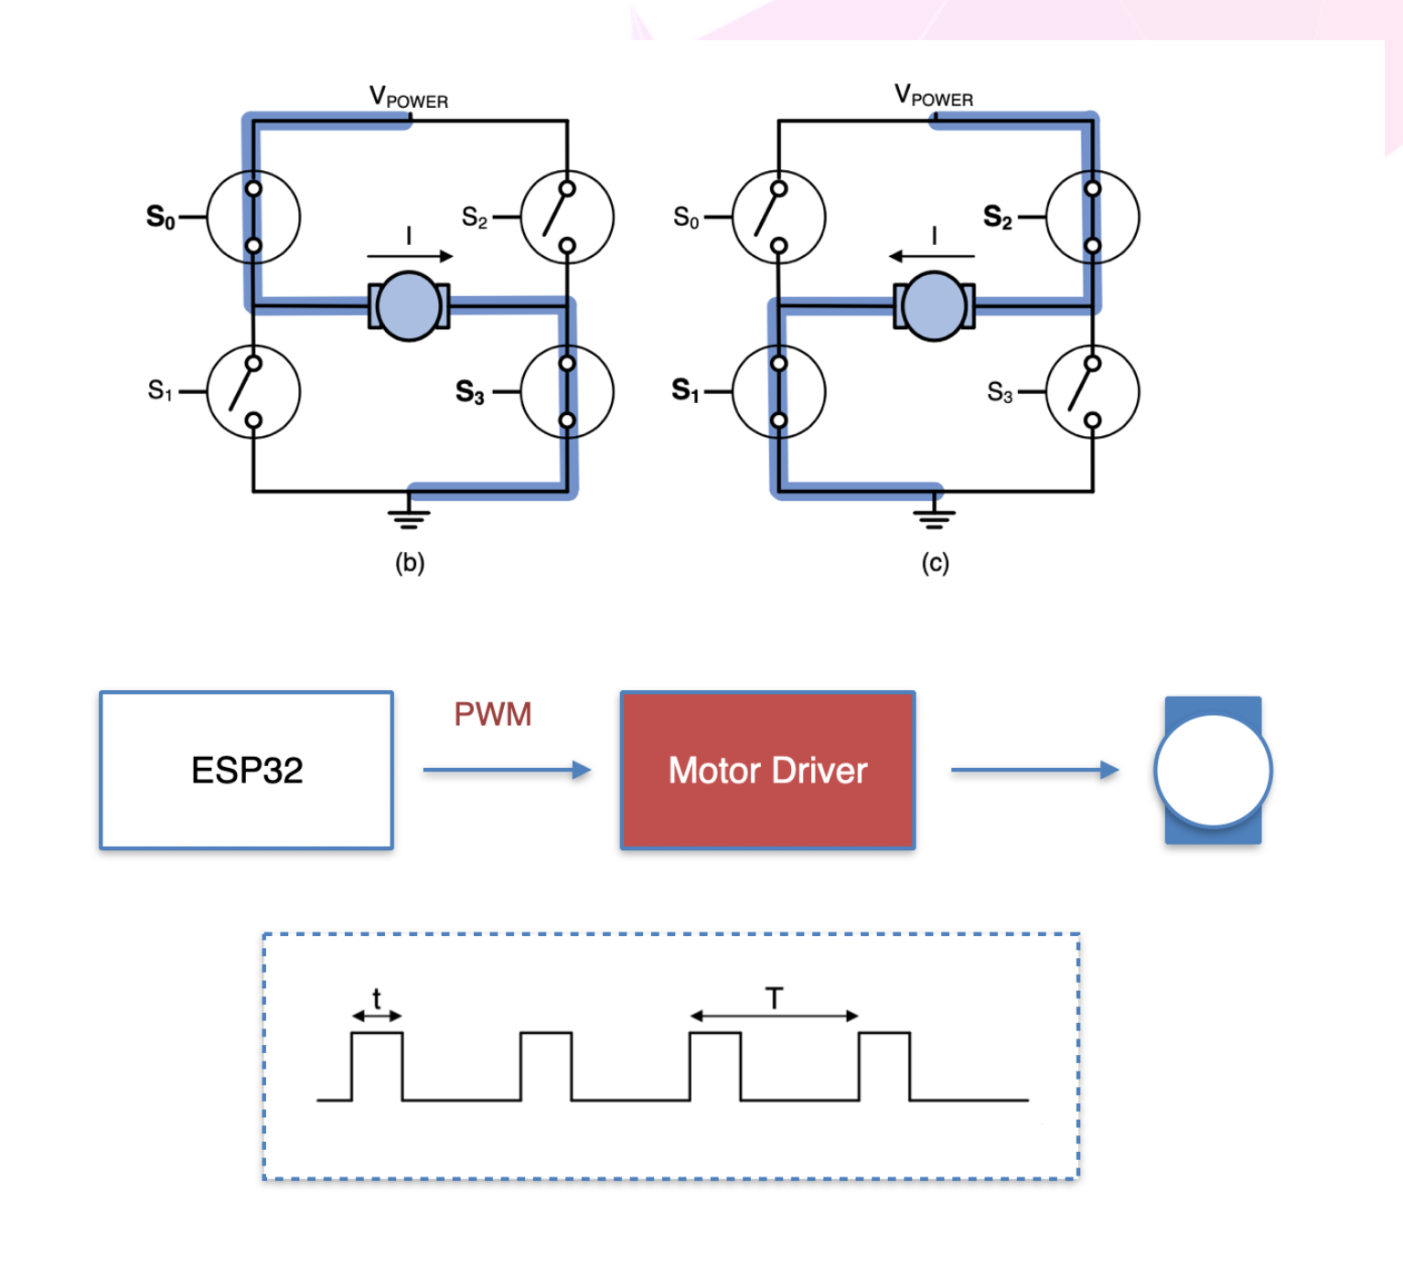
iFBalance
Pulse Width Modulation
(PWM)

Slide 53
iFBalance
8th Program
Control DC Motor
https://github.com/ShantanuSen/KookminSeminar/tree/main/Color%20LED_Part%202%20(FreeRTOS)

Slide 54
iFBalance
Encoder

Slide 55
iFBalance
Encoder
Rotary movements → electrical signals
Absolute encoder | Incremental encoder
Computer mouse wheel, flow meter, conveyor belt, printer

Slide 56
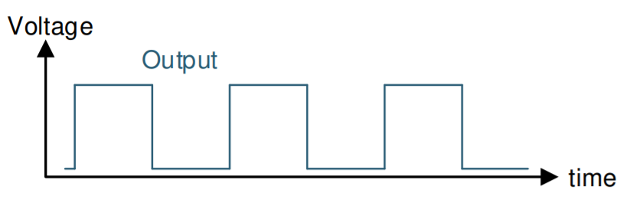
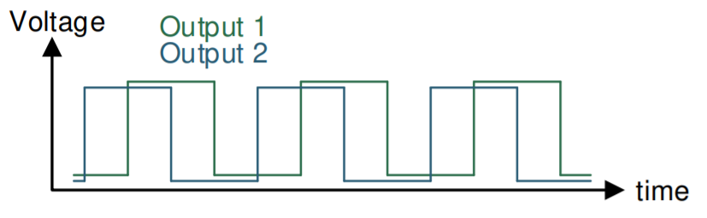
iFBalance
Encoder Types
Single Output
2-Bit Quadrature Output

Slide 57
iFBalance
Encoder Technologies
Technology
Contact
Optical
Inductive
Magnetic

Slide 58
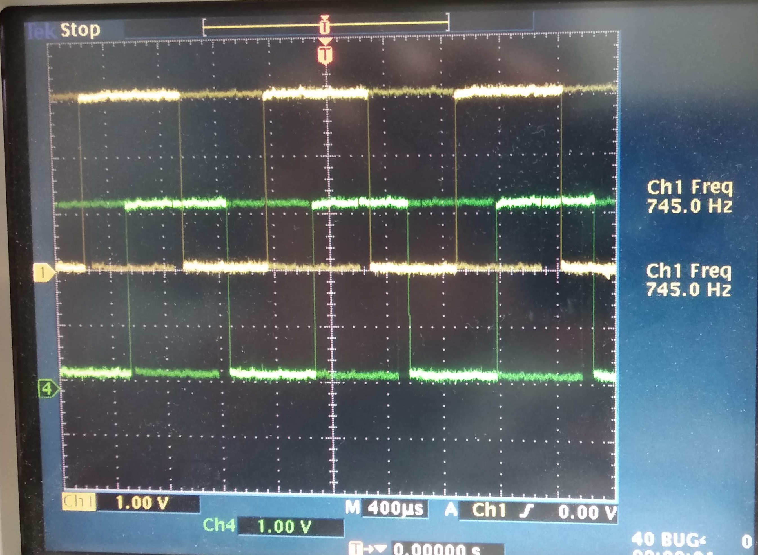
iFBalance
Encoder
Hall Sensor
N
1
1
0
0
A
1
1
0
0
B
S
Hall Sensor

Slide 59


iFBalance
Encoder
for left motor:
countLeft += (lastLeftA ⊕ newLeftB) – (newLeftA ⊕ lastLeftB)
How to Calculate speed from encoder?
Pin 1 (A) | Pin 2 (B) | Direction
H (Last) | H (Last)
L (New) | H (New) | H⊕H – L⊕H = 0 – 1 = -1
L | L | L⊕L – L⊕H = 0 – 1 = -1
H | L | L⊕L – H⊕L = 0 – 1 = -1

Slide 60
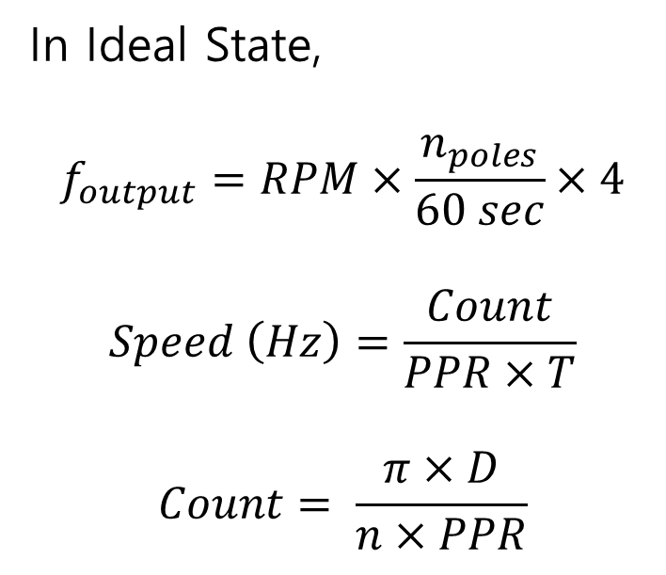
iFBalance
Encoder, PWM, RPM
No. of Poles
Revolutions per minute
In Ideal State,
$$f_{output}=RPM×\frac{n_{poles}}{60 sec}×4$$
$$Speed \left(Hz\right)=\frac{Count}{PPR×T}$$
$$Count= \frac{π×D}{n×PPR}$$
Sampling frequency
Pulses per revolution
(Encoder resolution)
Nominal diameter of wheel (mm)
Gear ratio
Bharat Joshi, Rakesh Shrestha, Ramesh Chaudhary. “Modeling, Simulation and Implementation of Brushed DC Motor Speed Control Using Optical Incremental Encoder Feedback”, Proceedings of IOE Graduate Conference, 2014
Notes:
Not Sure

Slide 61
iFBalance
Encoder
Encoder Pin GPIO
LEFT_A IO25
LEFT_B IO14
RIGHT_A IO13
RIGHT_B IO15

Slide 62
iFBalance
Encoder Interrupt
Interrupt attach to hardware pin
attachInterrupt(m_nLeA, leftISR, CHANGE);
attachInterrupt(m_nLeB, leftISR, CHANGE);
attachInterrupt(m_nReA, rightISR, CHANGE);
attachInterrupt(m_nReB, rightISR, CHANGE);

Slide 63
iFBalance
Encoder Interrupt
Interrupt Service Routine (ISR)
void IRAM_ATTR iFEncoder::leftISR()
{
bool newLeftB, newLeftA;
portENTER_CRITICAL (& muxl);
newLeftB = digitalRead (m_nLeB);
newLeftA = digitalRead (m_nLeA); countLeft += (lastLeftA ^ newLeftB) - (newLeftA ^ lastLeftB);
if ((lastLeftA ^ newLeftA) & (lastLeftB ^ newLeftB)) {
errorLeft = true;
}
lastLeftA = newLeftA;
lastLeftB = newLeftB;
portEXIT_CRITICAL(&muxl);
}

Slide 64
iFBalance
9th Program
Calculate speed from encoder output
https://github.com/ShantanuSen/KookminSeminar/tree/main/Color%20LED_Part%202%20(FreeRTOS)

Slide 65
iFBalance
Motion Processing Unit (MPU)

Slide 66
iFBalance
INS ( Inertial Navigation System )
GPS ( Global Positioning System )
Barometer
ToF
UltraSonic
Lidar
Optical Flow
BMP388
VL53L3CX
Altimeter
AHRS
MRAG
( Attitude & Heading Reference System )
( Magnetic, Anglear Rate, Gravity )
MPU9250
IMU
Compass
( Inertial Measurement Unit )
+
Accelerometers
Gyroscopes
Magnetometers
iFBalance

Slide 67
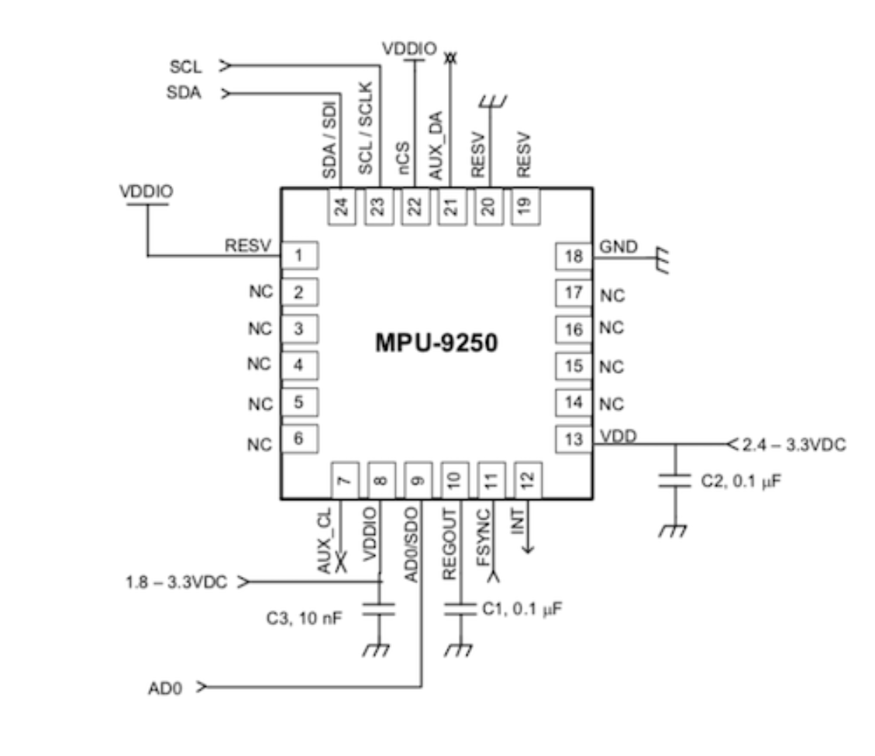
iFBalance
MPU9250 : IMU Sensor
Notes:
Roll direction change from original blog

Slide 68
iFBalance
MPU9250 : IMU Sensor
MPU Pin GPIO
I2C SDA IO21
I2C SCL IO22
MPU9250 Interrupt IO5
Notes:
Roll direction change from original blog

Slide 69

iFBalance
MPU9250 : IMU Sensor
Pitch + Offset
Yaw
0
Setpoint
Pitch
Back
Front
Roll
Notes:
Roll direction change from original blog

Slide 70
iFBalance
Yaw
Roll
Pitch

Slide 71
iFBalance
10th Program
Accelerometer, Gyroscope, & Magnetometer data from MPU9250
https://github.com/ShantanuSen/KookminSeminar/tree/main/Free%20RTOS%20Basic%20(HW%20ISR)

Slide 72
iFBalance
Proportional Integral Derivative (PID)

Slide 73
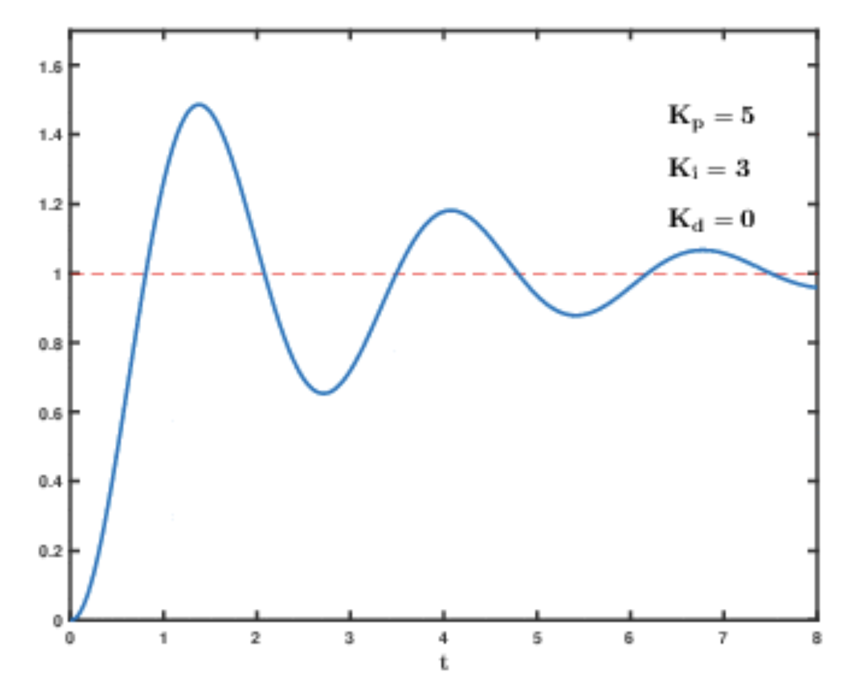
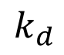
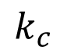

iFBalance
PID Control
Proportional
$$k_{p}$$
Integration
$$k_{c}$$
Differentiation
$$k_{d}$$

Slide 74
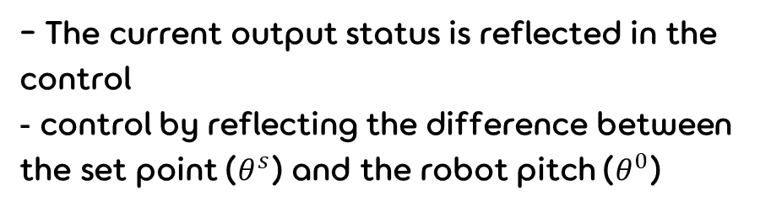
iFBalance
Opened Loop Control
Closed Loop Control
- It does not reflect the current output status
- The current output status is reflected in the control
control by reflecting the difference between the set point ($θ^{s}$) and the robot pitch ($θ^{0}$)
Reference
Error
Control signal
Output
r(t)
u(t)
y(t)
r(t)
e(t)
u(t)
y(t)
Controller
Process
Controller
Process
Sensor
Measured value

Slide 75
iFBalance
PID Control
Proportional
∝ error
Integration
steady state error
Differentiation
Overshoot Stability

Slide 76
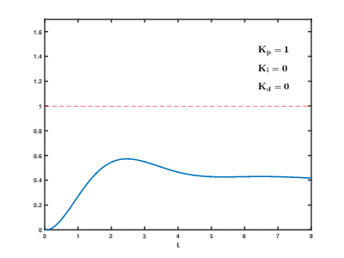
iFBalance
PID Control
GIF credit: https://commons.wikimedia.org/wiki/File:PID_Compensation_Animated.gif

Slide 77
iFBalance
PID Control
Set $k_{p}$
Set 𝑘_𝑝
Set $k_{i}$ & $k_{d}$ = 0
Set 𝑘_𝑖 & 𝑘_𝑑 = 0
Set $k_{i}$
Set 𝑘_𝑖
Fixed $k_{p}$
Fixed 𝑘_𝑝
Set $k_{d}$
Set 𝑘_𝑑
Fixed $k_{p}$ & Fixed $k_{i}$
Fixed 𝑘_𝑝 & Fixed 𝑘_𝑖
Start from (–) pitch value
Stop at (+) pitch value
Increase $k_{p}$
Increase 𝑘_𝑝
$k_{p}$ is set
𝑘_𝑝 is set
Increase $k_{i}$
Increase 𝑘_𝑖
Pitch repeats between (+) & (-)
Stop $k_{i}$ at uniform vibration
Stop 𝑘_𝑖 at uniform vibration
Stop at minimum overshoot

Slide 78
iFBalance
PID Controller
Proportional
P
Reference
Integral
PWM Motor Control
r(t)
u(t)
y(t)
Setpoint
e(t)
I
Process
Pitch
Differential
D
Measured value
IMU Sensor

Slide 79
iFBalance
iFBalance
Output
Proportional
Integral
Differential
0
Pitch + Offset
PID Control
Setpoint
System Variable
System
Back
Front
P
IMU Sensor
PWM Motor Control
Setpoint
Input
Error
I
Output
Measurement
Pitch
D
Time Interval ( Unit : Second ) : 0.005 sec

Slide 80
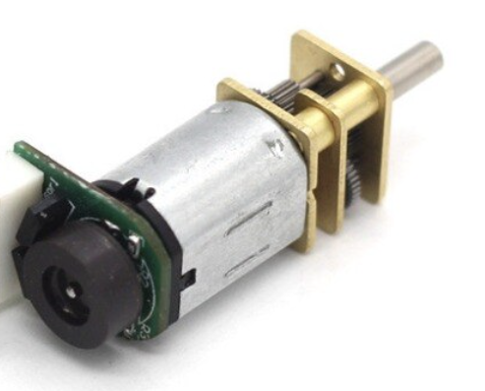
iFBalance
System
Left
Setpoint
Input
PID
Output
Mixer
Measurement
Right
Pitch

Slide 81
iFBalance
System
Pitch
Setpoint
Input
PID
Output
Measurement
Setpoint
Input
PID
Output
Measurement
Pitch

Slide 82
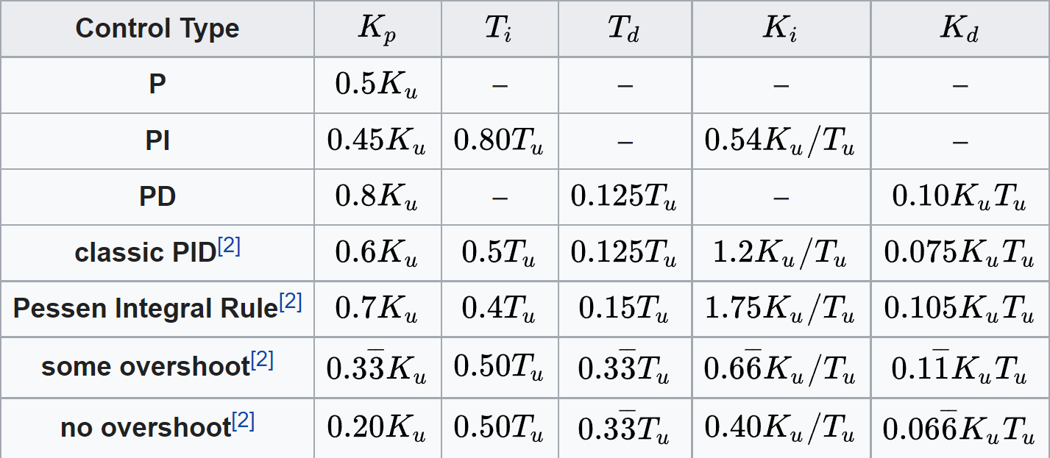
iFBalance
PID Control
Ziegler–Nichols method
 Heuristic PID control method
https://en.wikipedia.org/wiki/Ziegler%E2%80%93Nichols_method

Slide 83
iFBalance
11th Program
Speed control with PID
https://github.com/ShantanuSen/KookminSeminar/tree/main/Free%20RTOS%20Basic%20(HW%20ISR)

Slide 84
iFBalance
Time of Flight (ToF) Sensor

Slide 85
iFBalance
Time of Flight (ToF)
Field-of-View (FoV): 27 °
Time-of-Flight (ToF)
Laser-ranging sensor
2 Meter
I2C

Slide 86
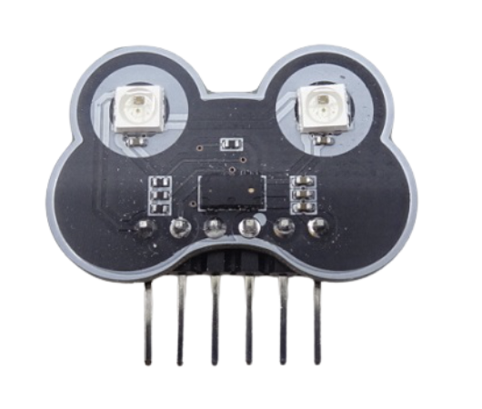
VL53L3CX
FoV 25º
300+ mm Detection
Multi Target Detection

Slide 87
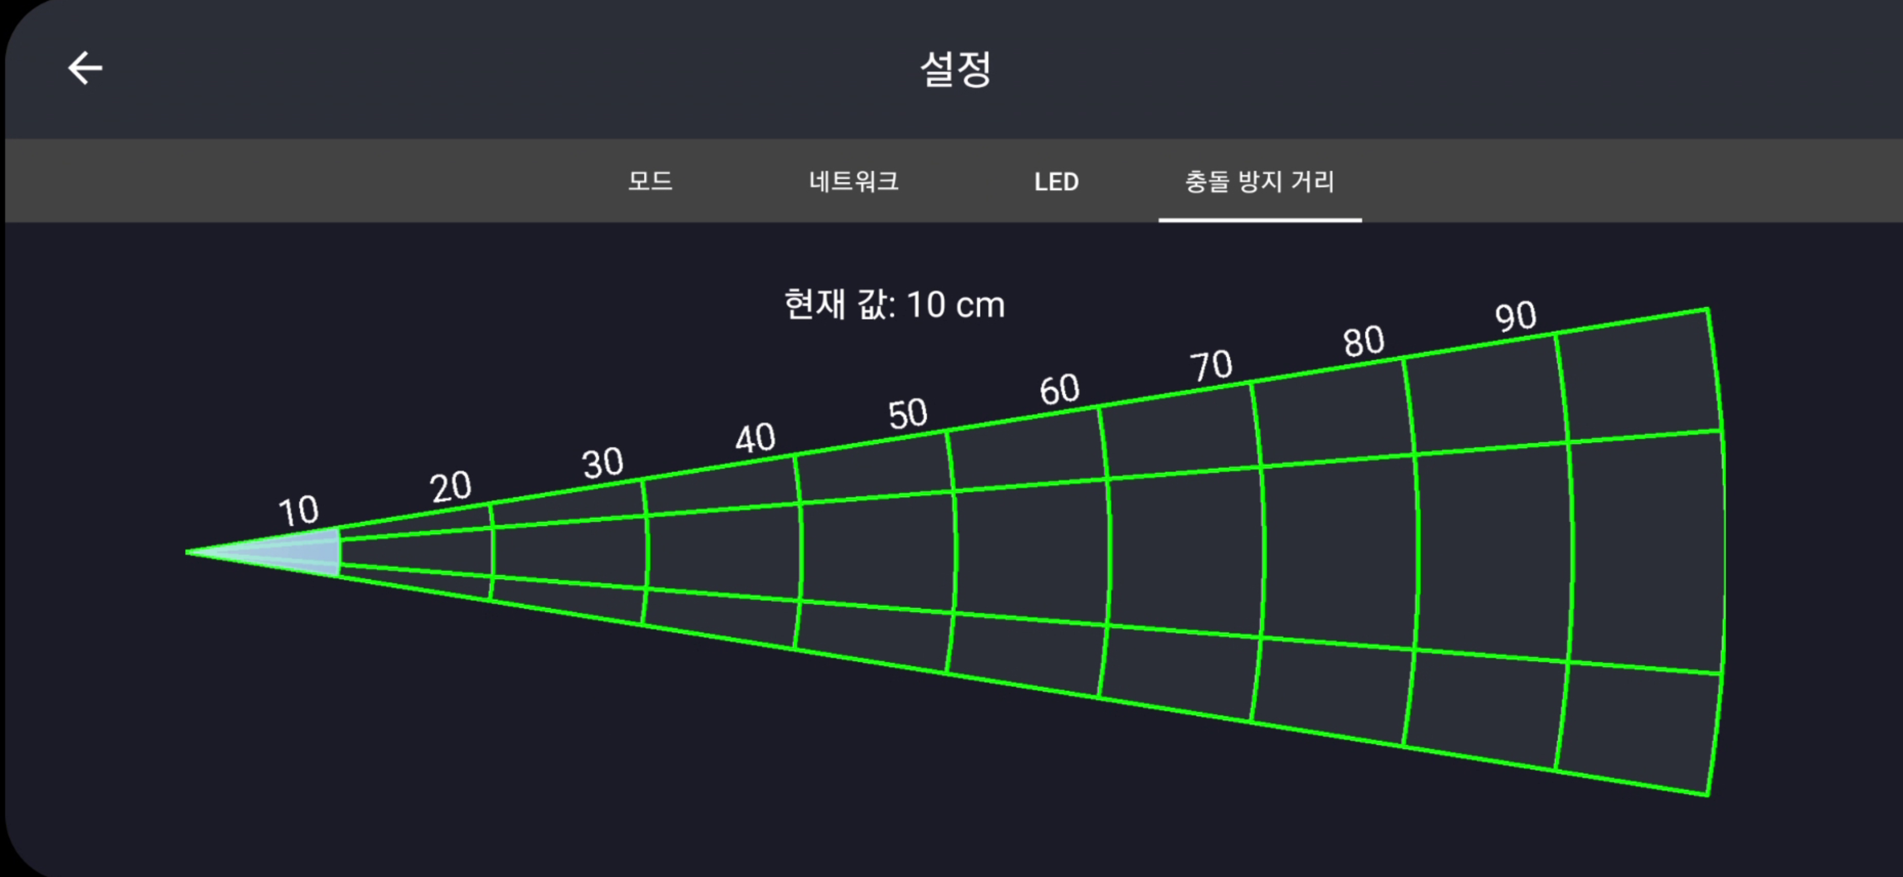
iFBalance

Slide 88
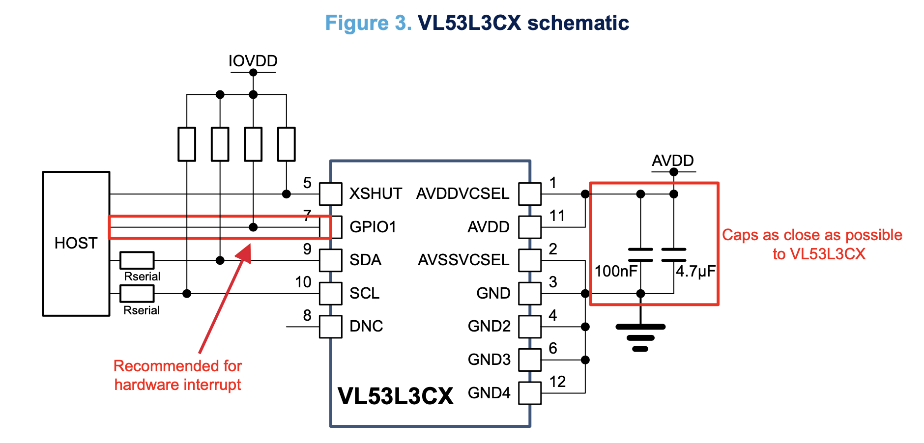
Chip On/Off

Slide 89
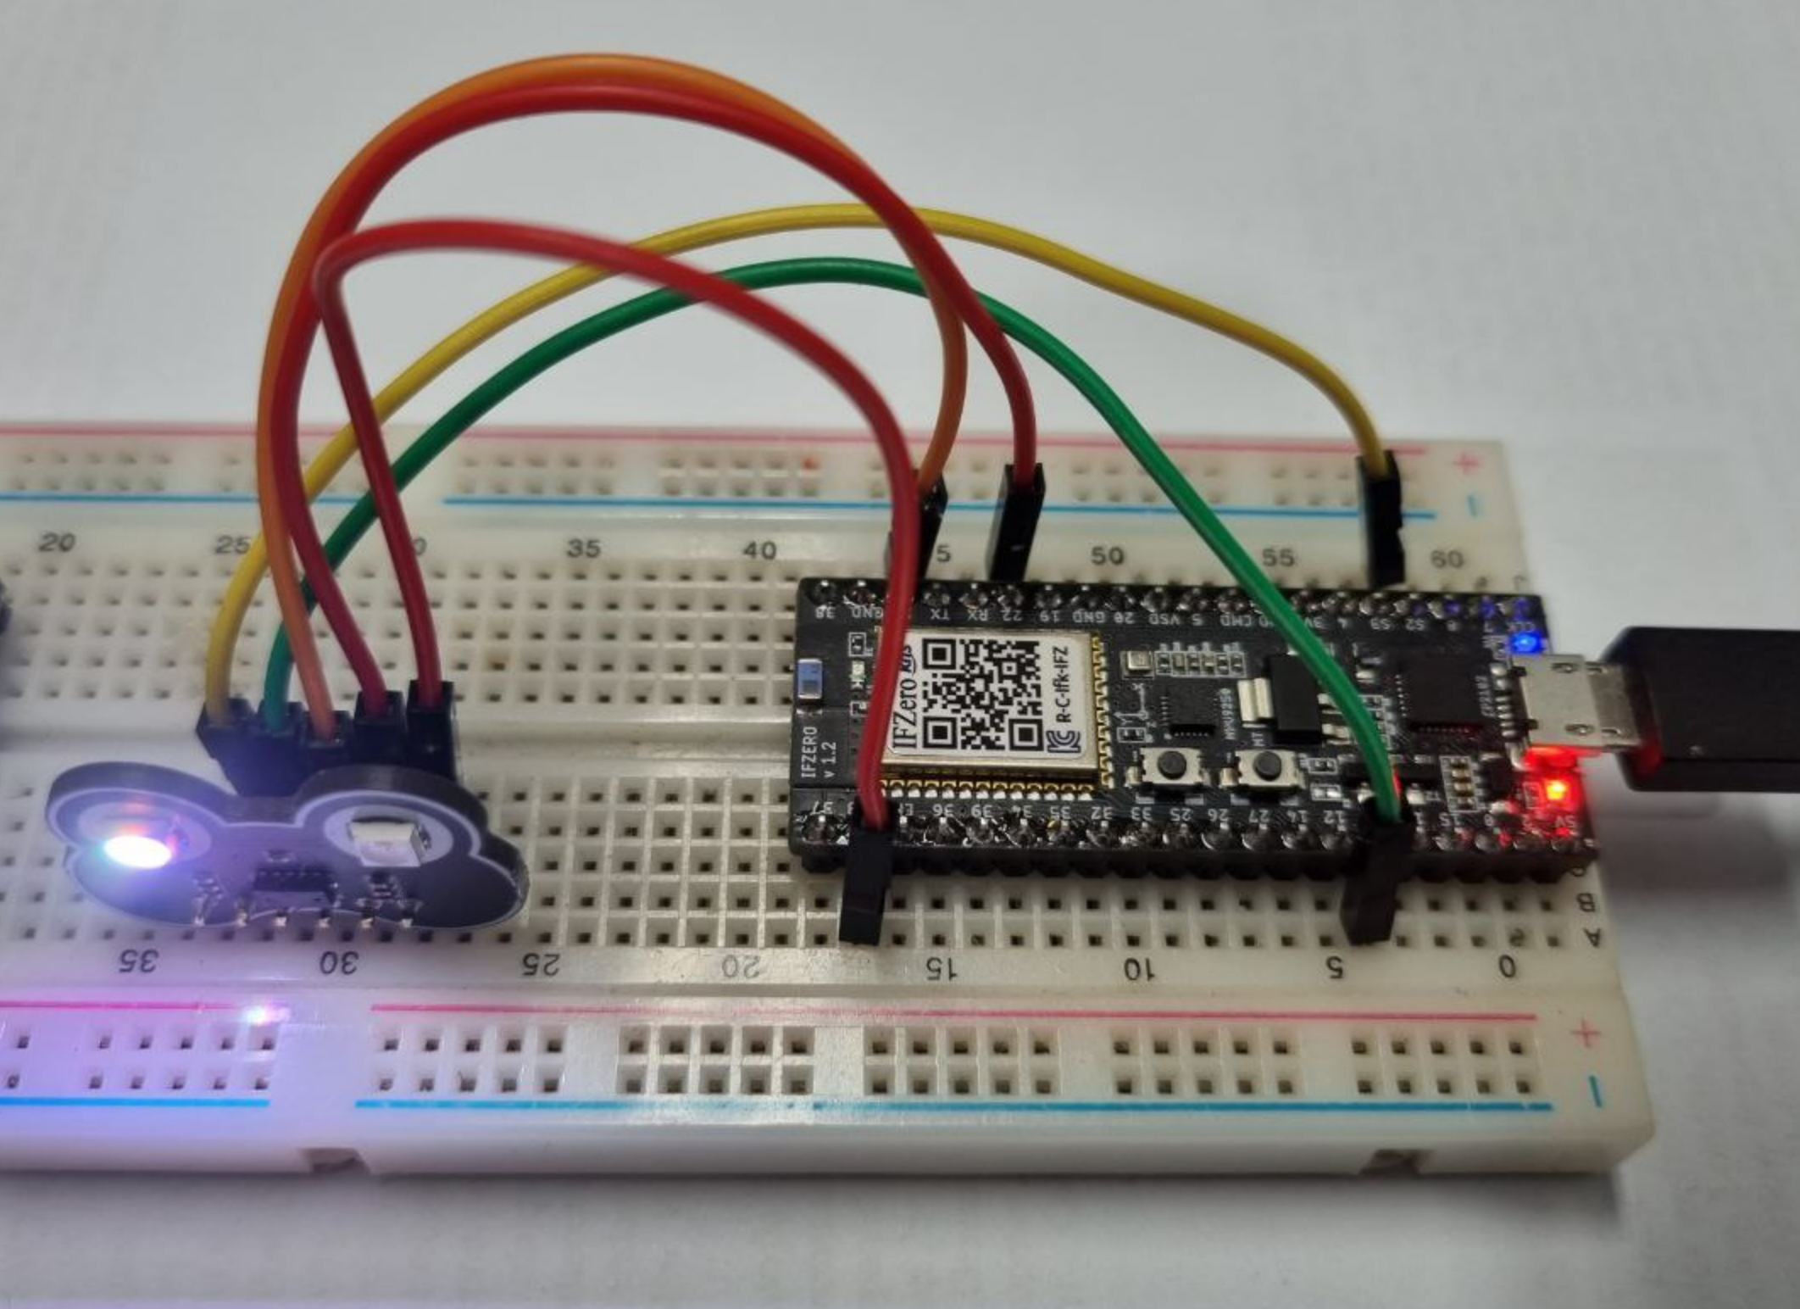

Slide 90
iFBalance
12th Program
Measure Distance Using ToF Sensor
https://github.com/ShantanuSen/KookminSeminar/tree/main/Free%20RTOS%20Basic%20(HW%20ISR)

Slide 91
IR Sensor Module

Slide 92
ESP 32 ADC → Group 1
ADC1 Channels GPIO
Channel 0 IO36
Channel 1 IO37
Channel 2 IO38
Channel 3 IO39
Channel 4 IO32
Channel 5 IO33
Channel 6 IO34
Channel 7 IO35

Slide 93
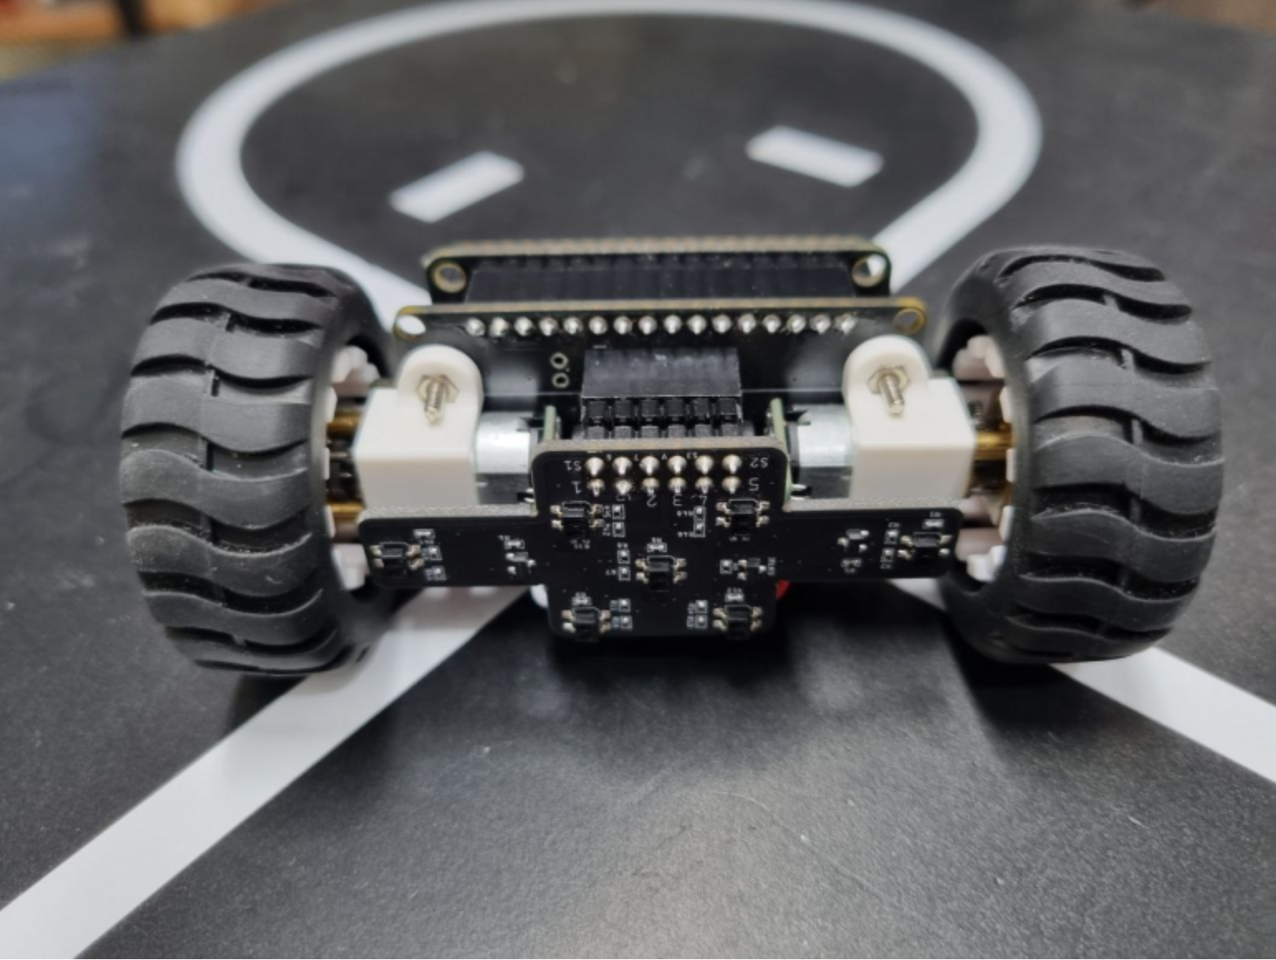
IR Sensor Position
Right Font
Left Front
Left Most
Right Most
Left Back
Right Back
Center

Slide 94
IR Sensor Pair → GPIO
Sensor Location GPIO
Left Most (LL) GPIO5
Center (CC) GPIO5
Right Most (RR) GPIO5
Left Back GPIO4
Right Front GPIO4
Left Front GPIO20
Right Back GPIO20
Group 1
Group 2
Group 3

Slide 95
iFBalance
13th Program
Read IR Sensor Module
https://github.com/ShantanuSen/KookminSeminar/tree/main/Free%20RTOS%20Basic%20(HW%20ISR)

Slide 97
iFBalance
Line Track Specification and IR Sensor Placement
1cm
https://blog.naver.com/serimo/222007740015

